Slide 1
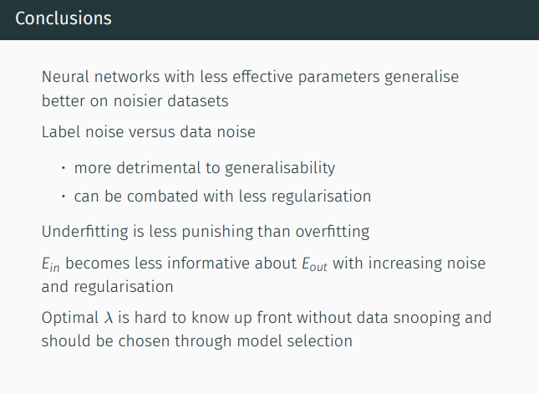
test

Slide 2
SVM Kernels:
linear
vs polynomial
vs RBF kernel
Question: How do they compare, given non linear data?

Slide 3
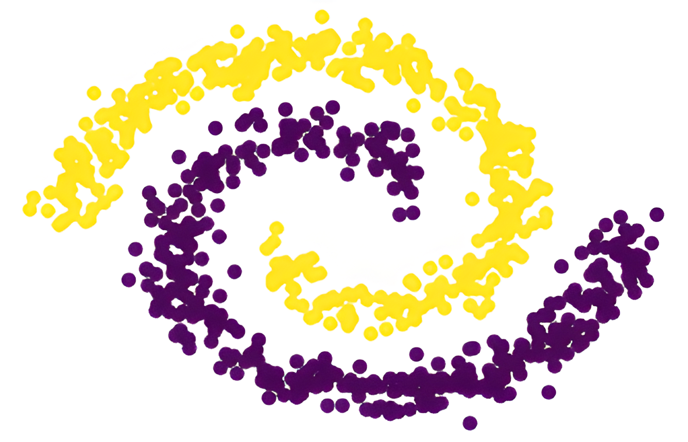
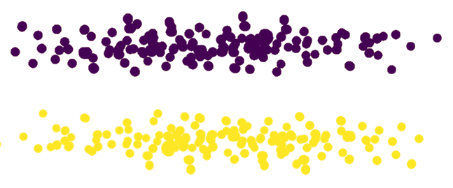


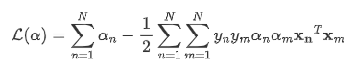
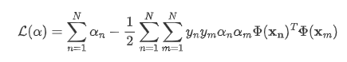
Why do we even need kernels?

Slide 4
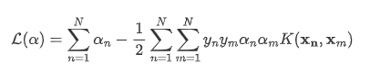
Why do we even need kernels?

Slide 5
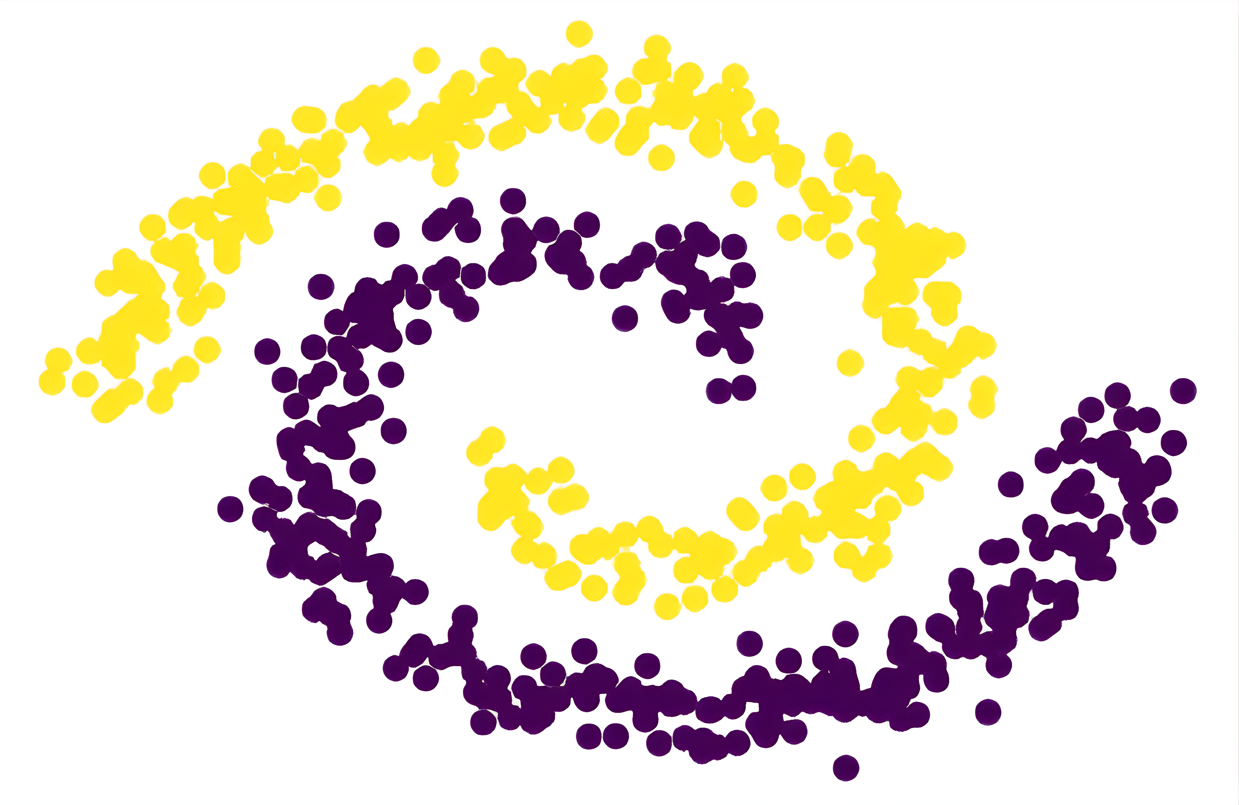
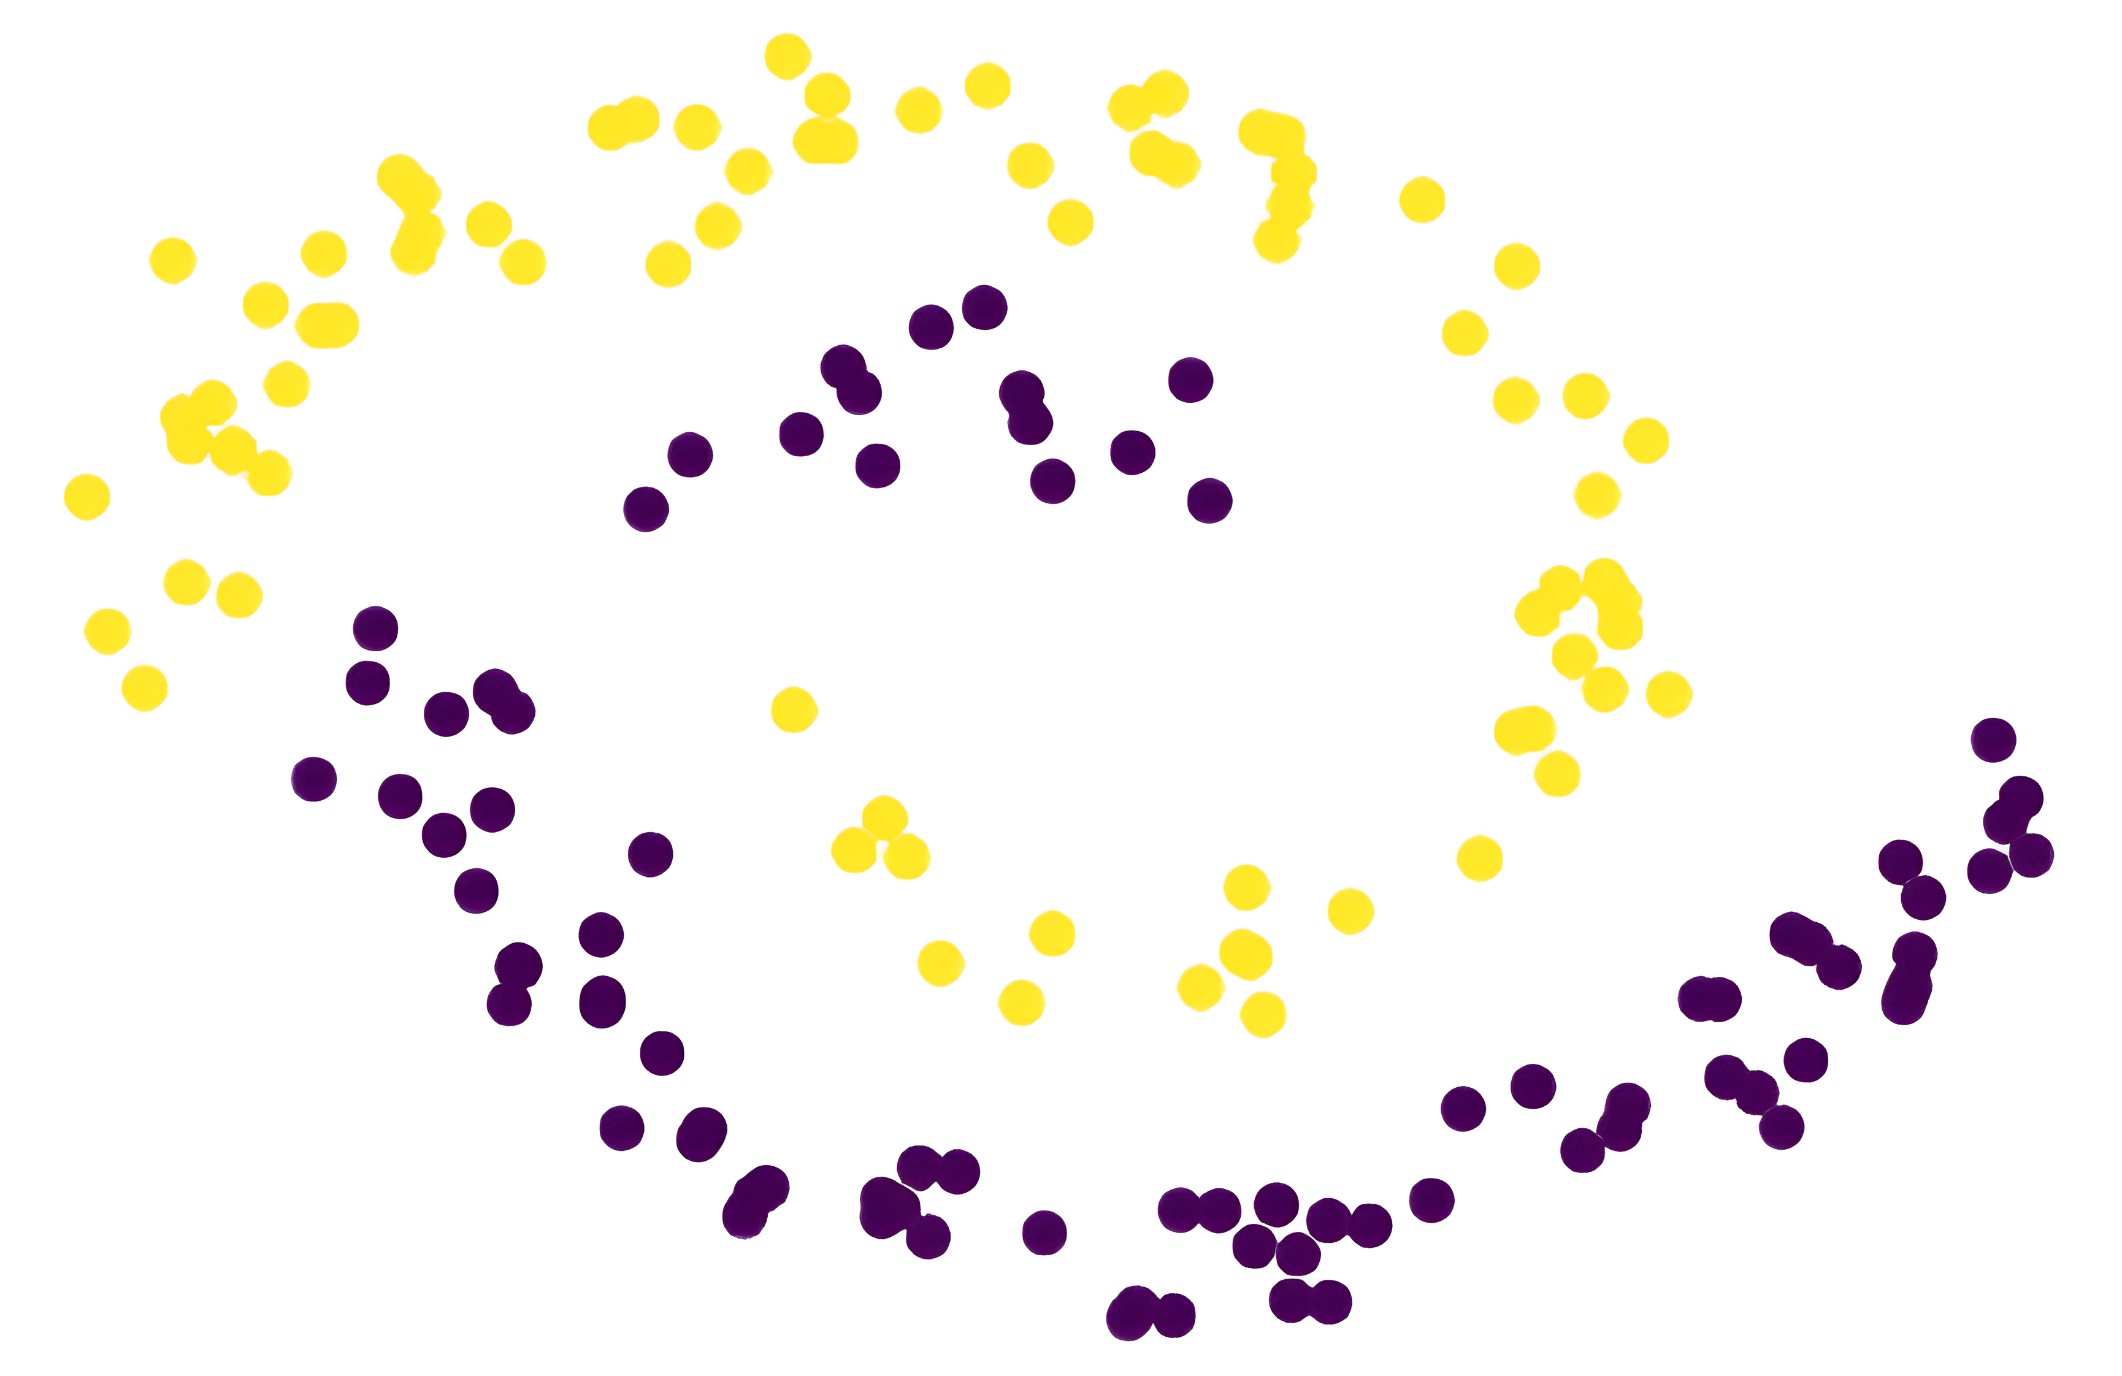
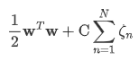
Setup
=
+
Train
Test
Soft margin constraint
> linear = svm.SVC(kernel='linear', C=1000)
> linear = model.fit(X_train, y_train)
> poly = …
> rbf = …
Notes:
Also, remember that total violation we used in soft margin svm, that’s what C corresponds to in sklearn
C is eig regularization param

Slide 6
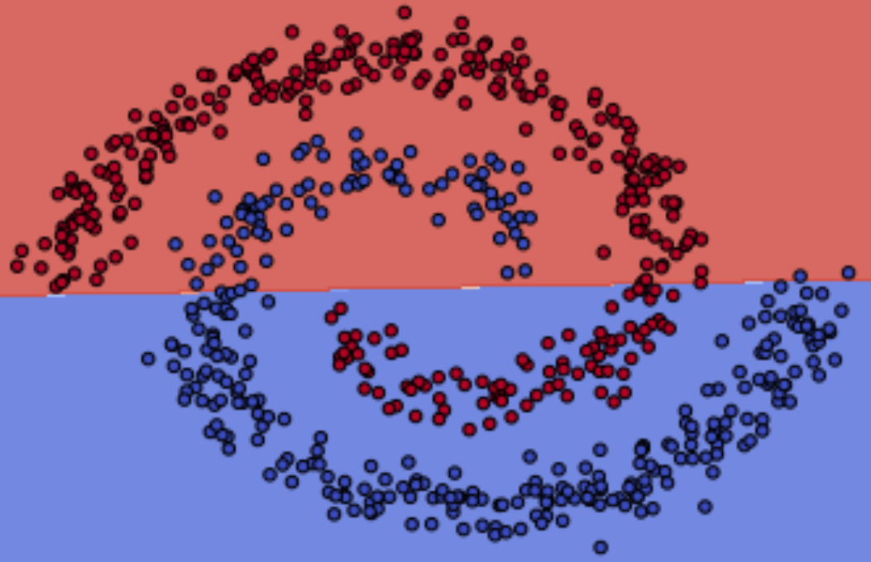
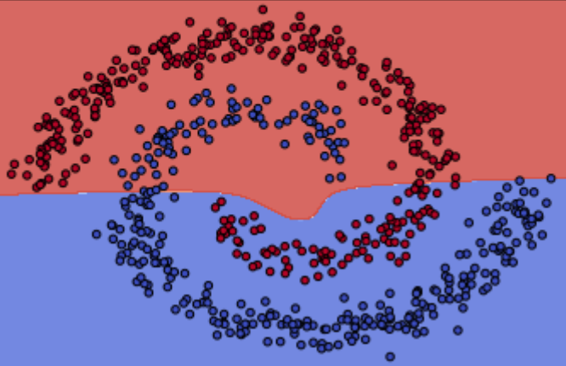
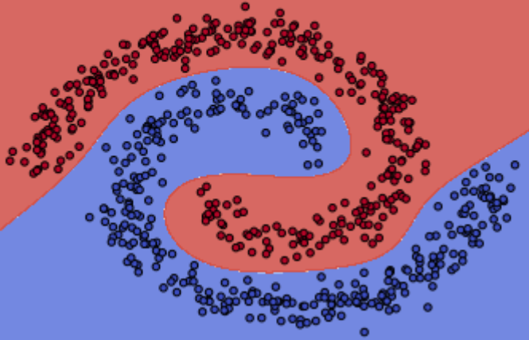
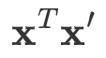
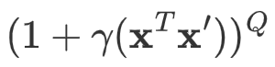
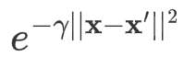
Results and interpretation
Linear
Polynomial
RBF
Q = 3
𝛾 = 1 / (N_train * X_train.var())
Notes:
What we see here is the decision boundary for each of the 3 models, each trained on a diff kernel.
----
Intuitively, the gamma parameter defines how far the influence of a single training example reaches, with low values meaning ‘far’ and high values meaning ‘close’. The gamma parameters can be seen as the inverse of the radius of influence of samples selected by the model as support vectors.
The C parameter trades off correct classification of training examples against maximization of the decision function’s margin. For larger values of C, a smaller margin will be accepted if the decision function is better at classifying all training points correctly. A lower C will encourage a larger margin, therefore a simpler decision function, at the cost of training accuracy. In other words C behaves as a regularization parameter in the SVM.

Slide 7
Results and interpretation
Linear
Polynomial
RBF
Difference in the flexibility between the three kernels
Only RBF can replicate the spiral shape
Notes:
Results and interpretation
The three graphs above display each display the decision boundary of a specific kernel. The plotted data points consist of the training set. From the graph we can see there is a clear difference in the flexibility between the three kernels. The linear kernel is only able to separate the data by drawing a single line. It is clearly not able to replicate the spiral shape of the training set. In the case of the polynomial kernel, by default Sklearn uses a number of degrees equal to three. This value corresponds to the 𝑄 in the polynomial kernel mentioned above. The higher the number of degrees, the more flexible the decision boundary becomes. Although the polynomial kernel with degree = 3, does not split the data correctly, the shape of its decision boundary is more similar the spiral shape than the linear linear decision boundary. We try higher degrees of freedom later. Note that the higher the degrees, the more prone the model is to overfitting. From the third graph above, we can see that the RBF kernel manages to fit the training set really well.
The parameter Gamma 𝛾γ was left unchanged since the default value obtained the best results.
^^ sees polynom gets closer than linear, so tried out different degrees of freedom

Slide 8
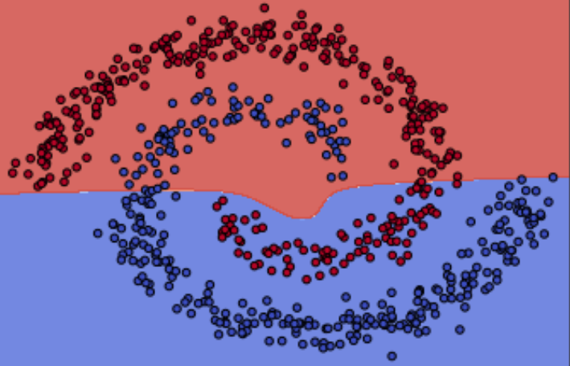
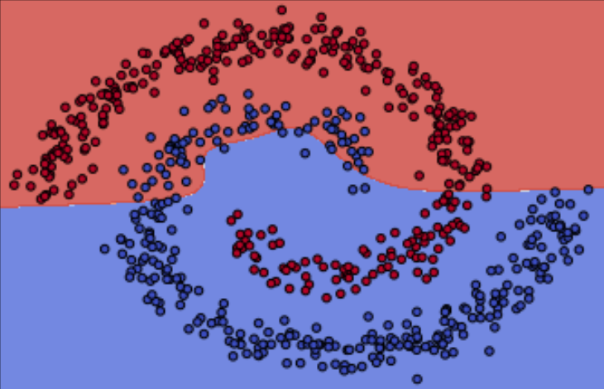
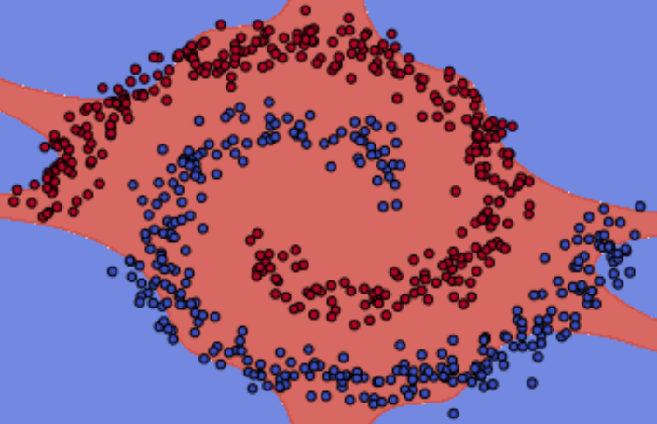
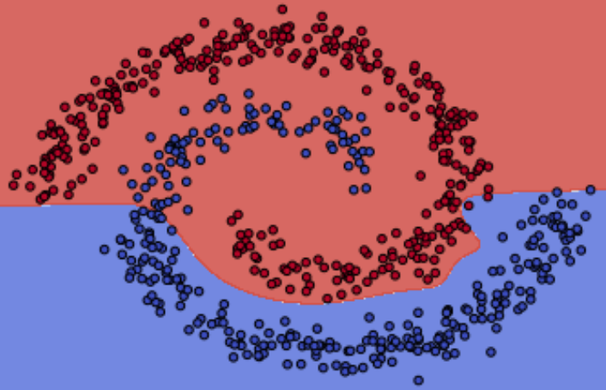
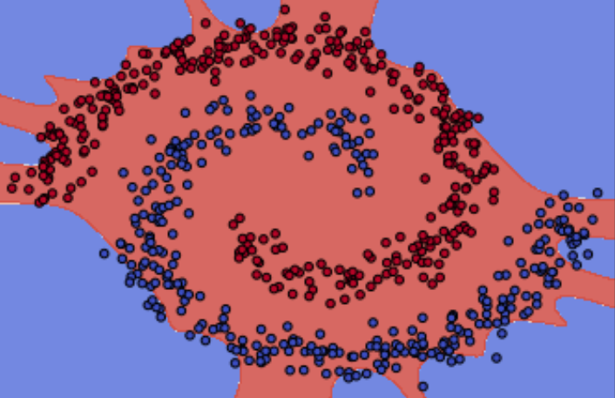
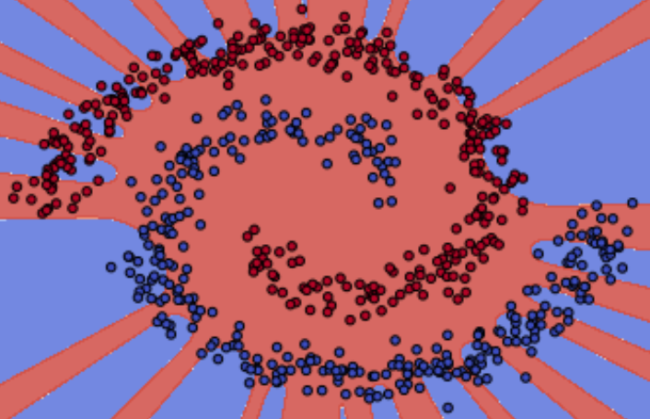
Polynomial kernel: different degrees of freedom
3 degr
5 degr
10 degr
15 degr
20 degr
30 degr

Slide 9
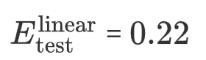
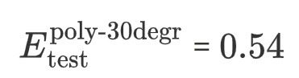


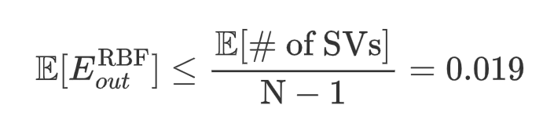
Conclusion
Linear
Polynomial (30 degr)
RBF
#SV’s: 371/800
#SV’s: 492/800
#SV’s: 15/800
Notes:
Conclusion: not only is RBF cable of simulating spiral shape much better, also much better out of sample err.

Slide 10
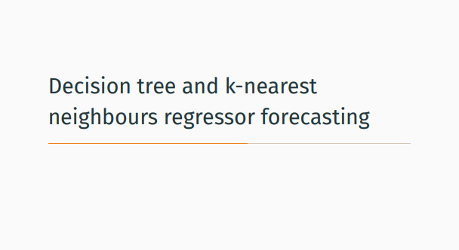

Slide 11
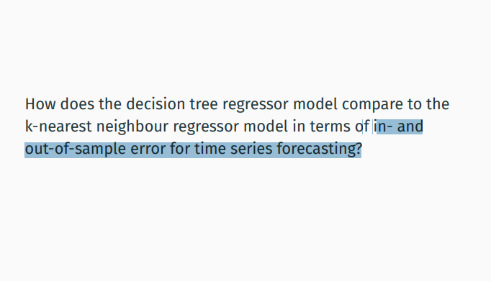

Slide 12
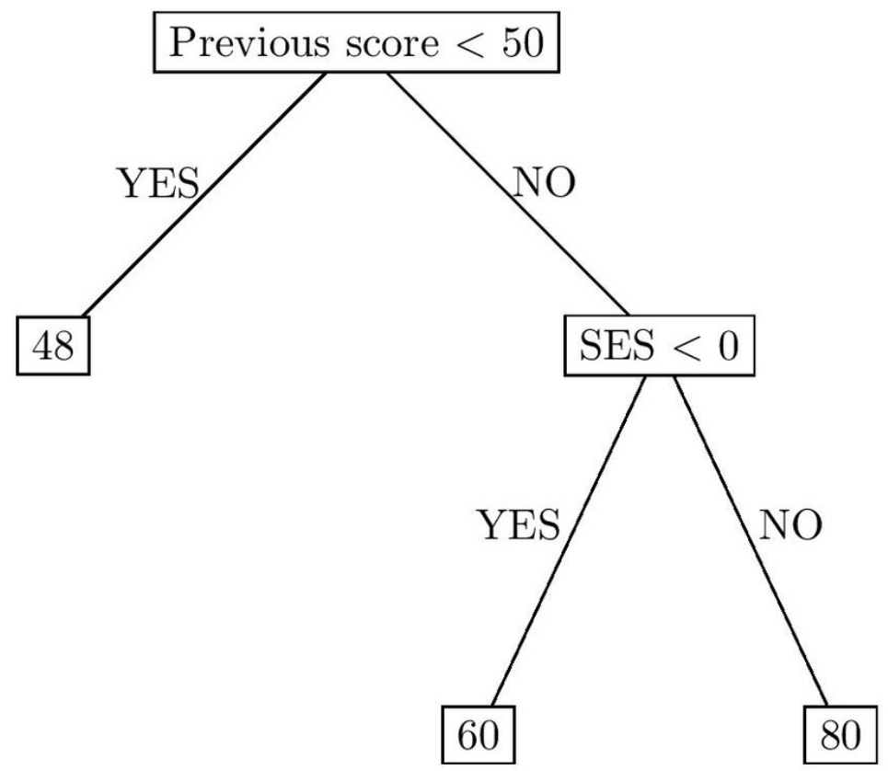
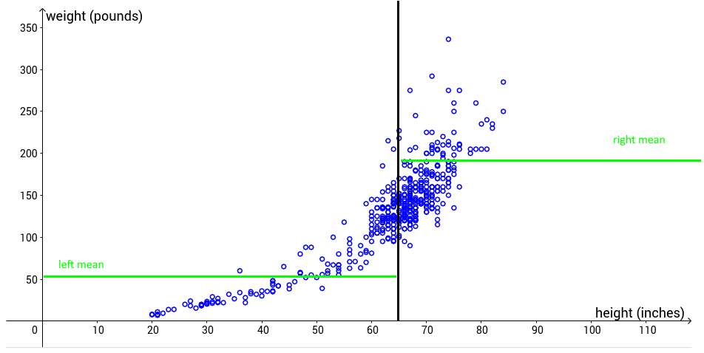
Decision tree regression
Splits data into groups
Training: searches best features/thresholds to split groups
!! Model = decision tree
Notes:
Regression trees work by splitting data in groups, the predicated value for a group corresponds to the mean of that particular group.
The training process corresponds to finding the best thresholds and finding the best features to use to make those groupings. The result of training is a node.
^^ done by searching threshold that minimizes residual error from mean.
Important: there is a model!

Slide 13
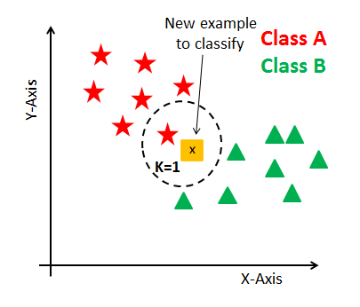
K-Nearest Neighbor (KNN)
!! Model = the data
Prediction: mean of target values in neighborhood

Slide 14
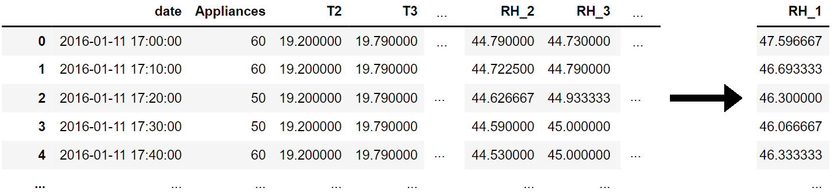
Dataset
Given: temperatures + humidity of specific rooms in the house
Objective: predict Room Humidity in kitchen
Measurement every 10 minutes, for 4 months
Notes:
Let us try to predict appliances data
To compare the two algors by …
Given room temperature of specific rooms in a house, goal: predict humidity of one specific

